Slide 3
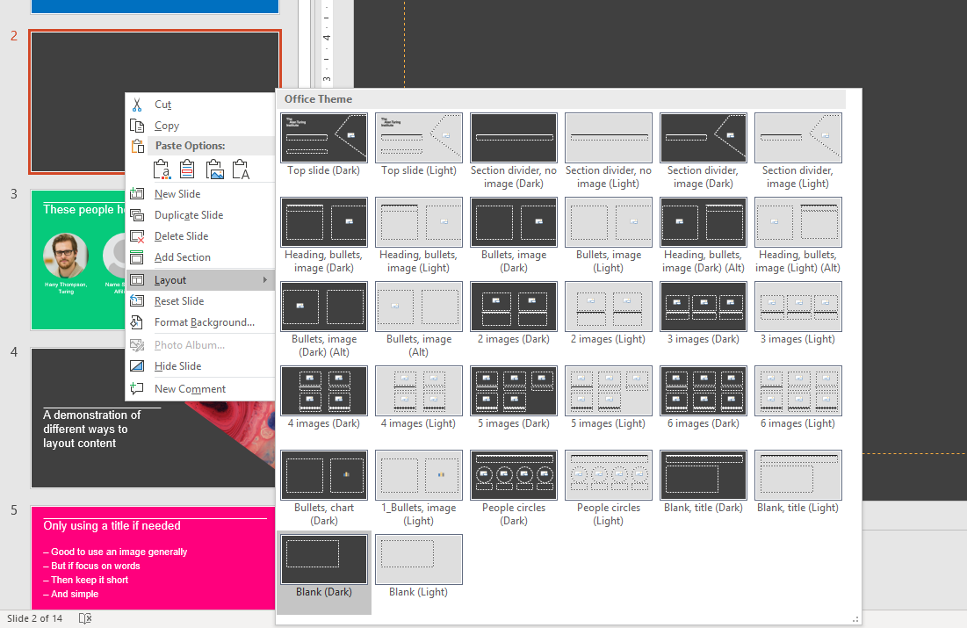
Right click
Layout
Choose a layout
Dark or light backgrounds

Slide 5


Slide 6
Heading | Heading
Text | Text

